Slide 1
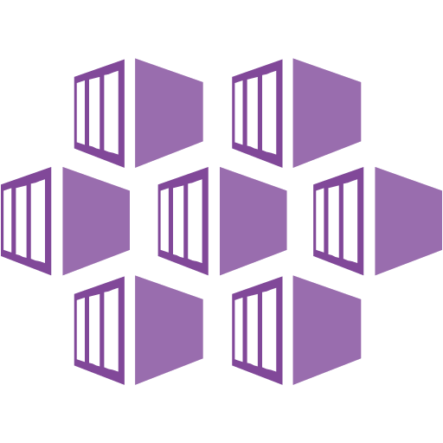
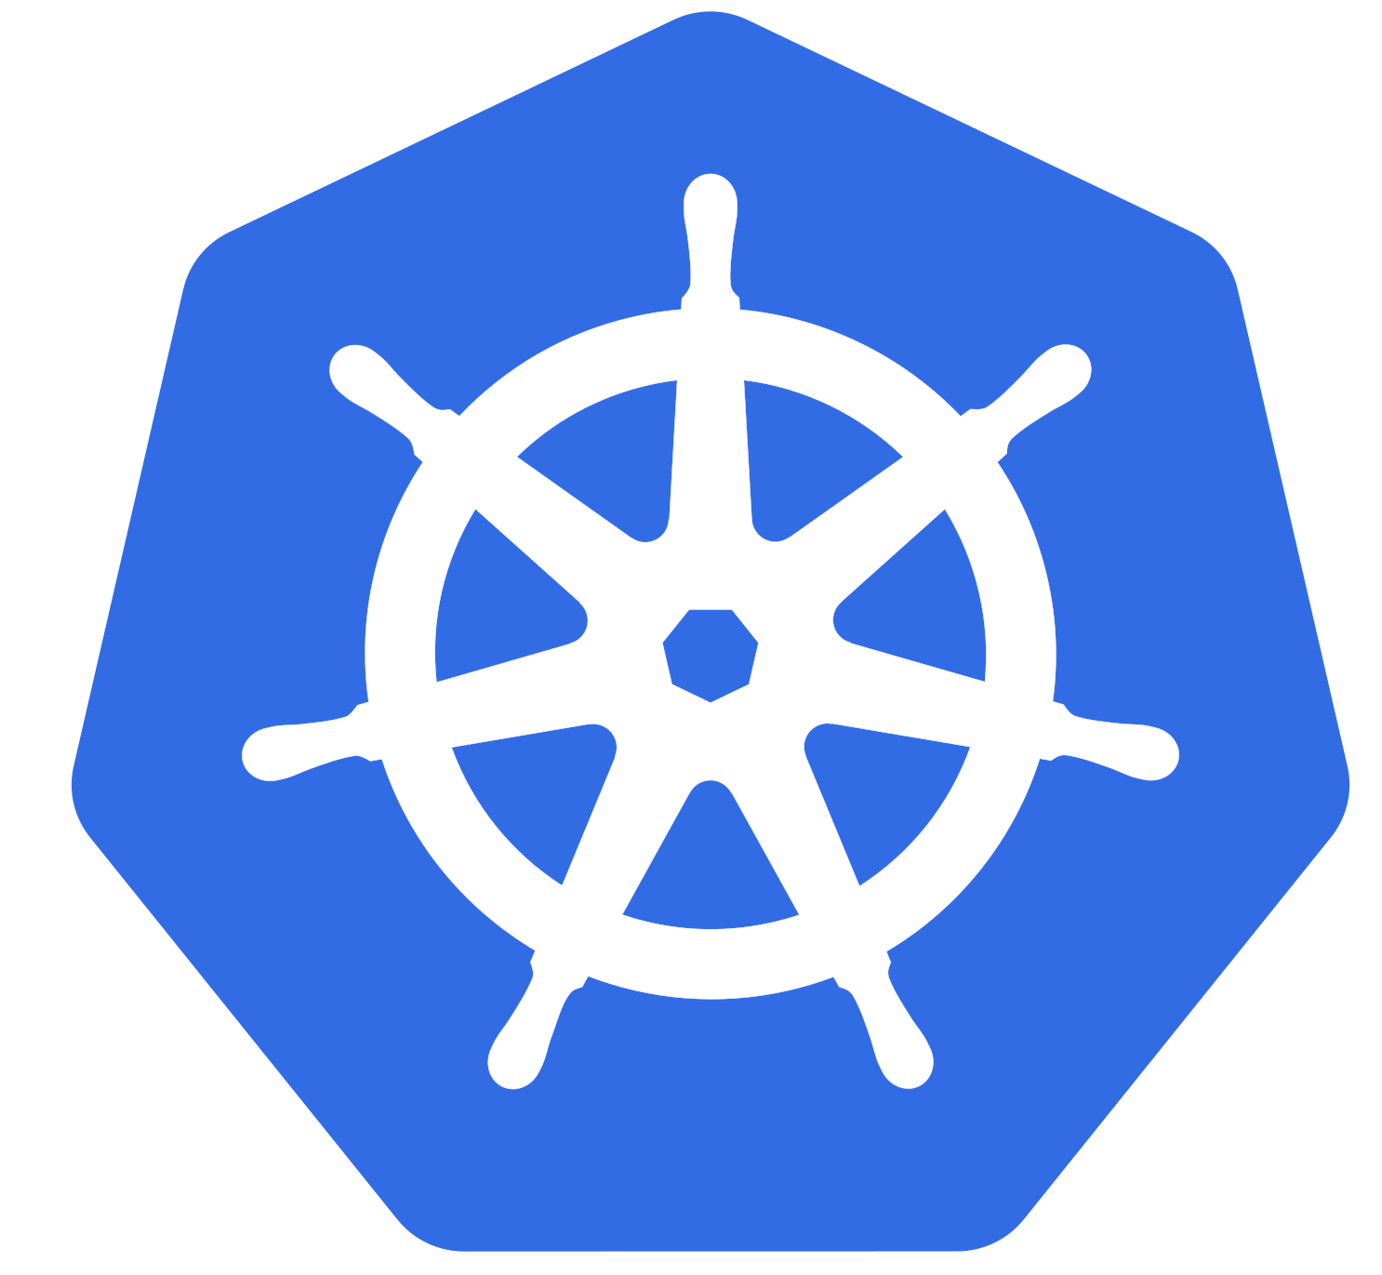
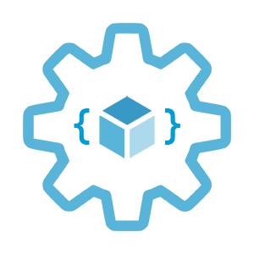

Introduction to Azure Kubernetes Service (AKS)
Infrastructure as Code User Group Oslo
09.02.2021
Evgeny Borzenin

Slide 2
Agenda
17:05 – start
Welcome
Microsoft Azure Badges
Practical info
Start workshop

Slide 3
Practical information
Mix of slides and labs
I don’t have moderator
Let’s help each other, the one who finished earlier can help others
Keep the same names as in labs -> easier to troubleshot
Share your screen if you stack with something
Labs are available after the event

Slide 4
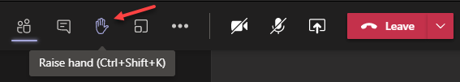
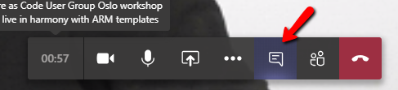

Microsoft Teams 101
Mute your mic (but don’t forget to unmute when you speak)
Feel free to use video
«Rise your hand» if you need some attention
Conversation/chat
If you want to have private discussion, find evgeny@enso.no and start chat with me
Share screen

Slide 5
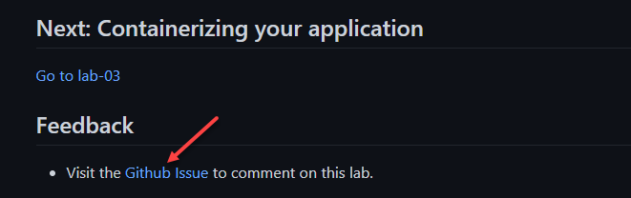
Practical information
Each lab is time-boxed (ish…)
When you completed a lab, please post to the Conversation channel
lab-01 (lab-02, lab-03 etc…)
Labs will be available after the event
Feel free to contribute to the labs content by fixing gramma, typos, wrong commands etc..
Feel free to comment on each lab

Slide 6
Workshop agenda
Slides - Kubernetes and AKS introduction (10 min)
Lab-01 - AKS setup (15 min)
Lab-02 - setting up you shell for better AKS/kubectl experience (15 min)
Slides - Introduce our "guinea pig" app (10 min)
Lab-03 - Containerizing your application (15 min)
Pause
Slides - Pods, Namespaces (10 min)
Lab-04 - Creating, managing and testing pods (15 min)
Slides - Readiness and Liveness probes (15 min)
Lab-05 - Readiness and Liveness probes (15 min)
Slides - Deployments (5 min)
Lab-06 - Deployments (15 min)
Pause
Slides - Services, Labels, Selectors (10 min)
Lab-07 - Creating and Managing Services (15 min)
Slides - Configmaps and secrets (5 min)
Lab-08 - Configmaps and secrets (15 min)
Lab-09 - AKS Kubernetes resources at the Azure portal (15 min)
Lab-10 - Cleaning up (5 min)

Slide 7
What does Kubernetes and k8s mean?
Greek for pilot or Helmsman – the person who steers a ship
Kubernetes -> K(ubernete)s -> k8s

Slide 8
Kubernetes
Created by tree Google employees in 2014
Donated to Cloud Native Computing Foundation
Production version 1.0 in 2015
Written in Go

Slide 9
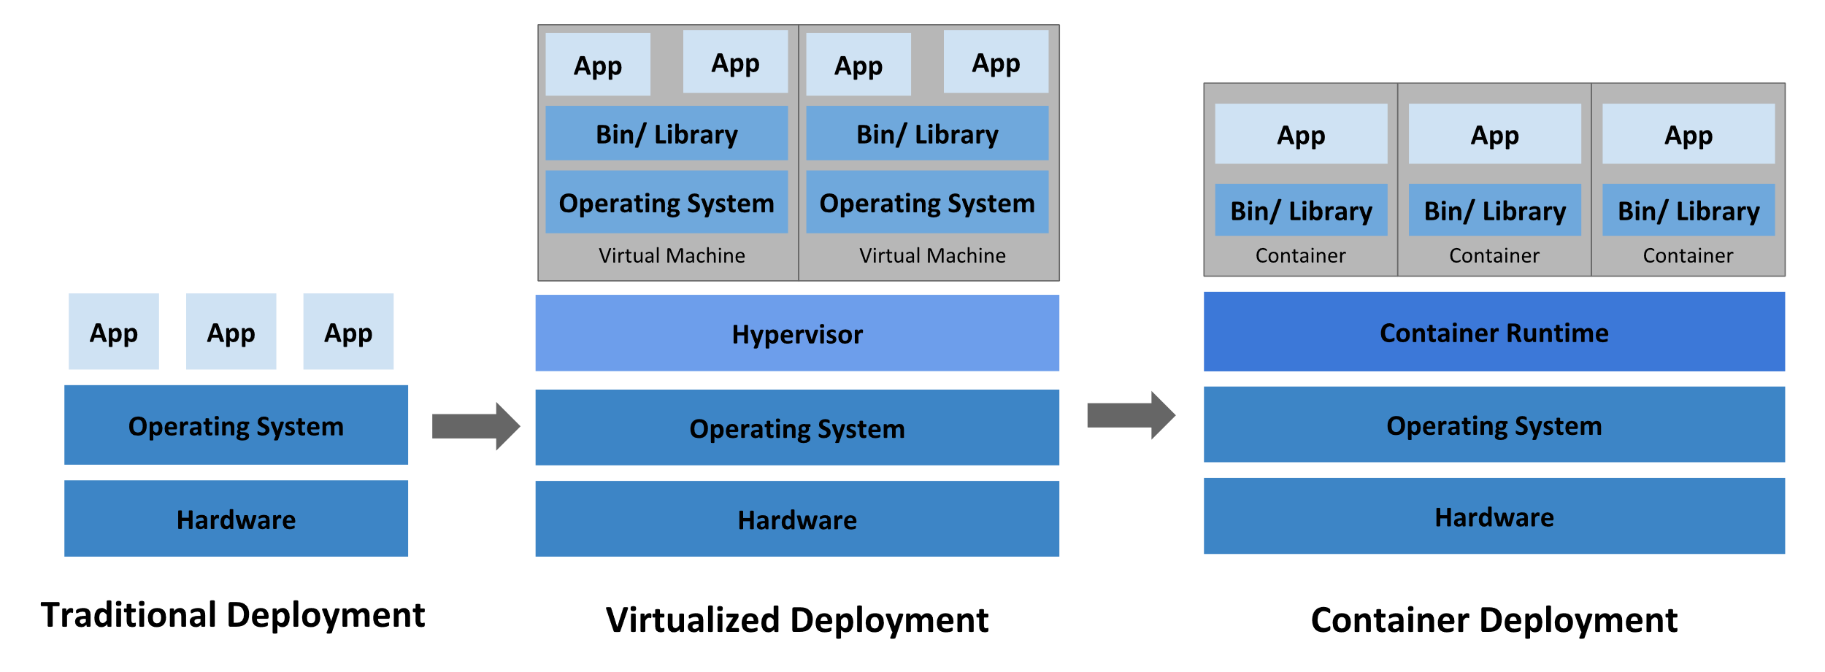
Container evolution
https://kubernetes.io/docs/concepts/overview/what-is-kubernetes/

Slide 10
Why you need Kubernetes
Service discovery and load balancing
Automated rollouts and rollbacks
Self-healing
Secret and configuration management
Notes:
Service discovery and load balancing
Kubernetes can expose a container using the DNS name or using their own IP address. If traffic to a container is high, Kubernetes is able to load balance and distribute the network traffic so that the deployment is stable.
Self-healing
Kubernetes restarts containers that fail, replaces containers, kills containers that don't respond to your user-defined health check, and doesn't advertise them to clients until they are ready to serve.
Secret and configuration management
Kubernetes lets you store and manage sensitive information, such as passwords, OAuth tokens, and SSH keys. You can deploy and update secrets and application configuration without rebuilding your container images, and without exposing secrets in your stack configuration.

Slide 11
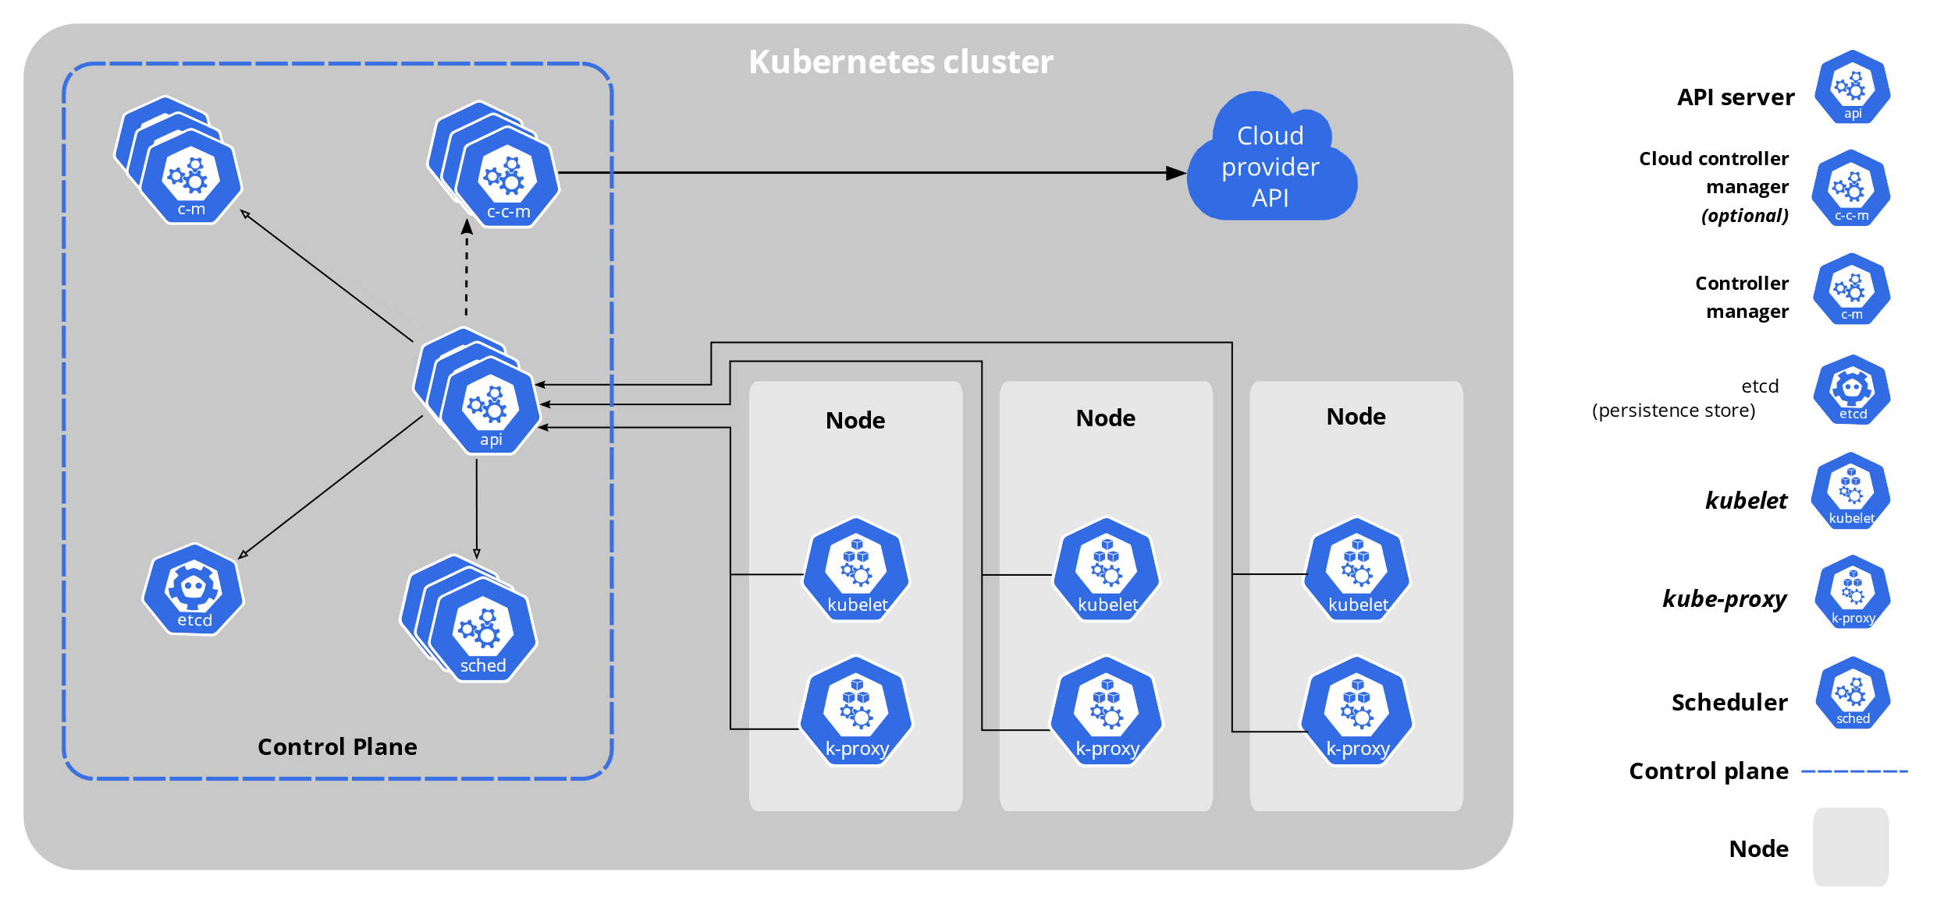
Kubernetes components
https://kubernetes.io/docs/concepts/overview/components/

Slide 12
Control Plane Components
kube-apiserver
Etcd
kube-scheduler
kube-controller-manager

Slide 13
Kubernetes concepts

Slide 14

Azure Kubernetes Service (AKS)
+
=
Notes:
Azure Kubernetes Service (AKS) is a managed Kubernetes offering that simplifies container-based application deployment and management.
Azure Kubernetes Service (AKS) provides a managed Kubernetes service that reduces the complexity for deployment and core management tasks, including coordinating upgrades.

Slide 15
AKS concepts

Slide 16
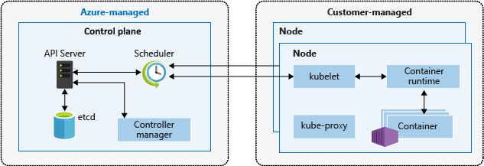
AKS cluster architecture
https://docs.microsoft.com/en-us/azure/aks/concepts-clusters-workloads
Notes:
The AKS control plane is managed by the Azure platform, and you only pay for the AKS nodes that run your applications. AKS is built on top of the open-source Azure Kubernetes Service Engine (aks-engine).
When you create an AKS cluster, a control plane is automatically created and configured. This control plane is provided as a managed Azure resource abstracted from the user. There's no cost for the control plane, only the nodes that are part of the AKS cluster.

Slide 17
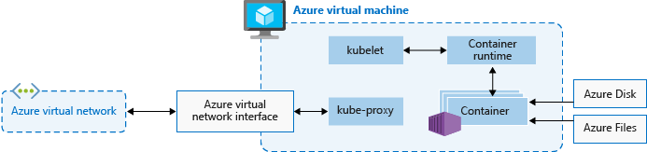
AKS nodes
https://docs.microsoft.com/en-us/azure/aks/concepts-clusters-workloads
Notes:
To run your applications and supporting services, you need a Kubernetes node. An AKS cluster has one or more nodes, which is an Azure virtual machine (VM) that runs the Kubernetes node components and container runtime.

Slide 18
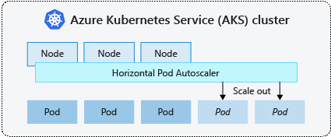
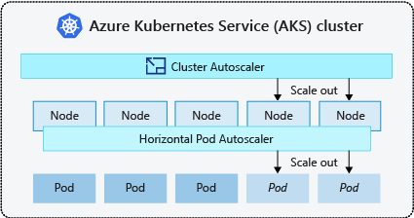
AKS scaling options
Manually scale pods or nodes
Horizontal pod autoscaler
Cluster autoscaler
https://docs.microsoft.com/en-us/azure/aks/concepts-scale
Notes:
You can manually scale replicas (pods) and nodes to test how your application responds to a change in available resources and state. Manually scaling resources also lets you define a set amount of resources to use to maintain a fixed cost, such as the number of nodes. To manually scale, you define the replica or node count.
Kubernetes uses the horizontal pod autoscaler (HPA) to monitor the resource demand and automatically scale the number of replicas. When you configure the horizontal pod autoscaler, you define the minimum and maximum number of replicas that can run. You also define the metric to monitor and base any scaling decisions on.
To respond to changing pod demands, Kubernetes has a cluster autoscaler, that adjusts the number of nodes based on the requested compute resources in the node pool. Cluster autoscaler is typically used alongside the horizontal pod autoscaler.

Slide 19
Lab-01, 02, 03

Slide 20
Pause

Slide 21
k8s 101: Pods

Slide 22
What does Kubernetes and k8s mean?
Greek for pilot or Helmsman – the person who steers a ship
Kubernetes -> K(ubernete)s -> k8s

Slide 23
Lab-04

Slide 24
k8s 101: Readiness and Liveness probes

Slide 25
Lab-05

Slide 26
k8s 101: Deployments

Slide 27
k8s 101: Pods

Slide 28
Lab-06

Slide 29
Pause

Slide 30
k8s 101: Services, Labels, Selectors

Slide 31
Lab-07

Slide 32
k8s 101: Configmaps and secrets

Slide 33
Lab-08, 09

